Slide 1
E - Commerce Purchase Data Analysis
M. Tech. – DSML → Team 7
Date: 24th Oct 2020
NPV – Project Presentation
PRAVEEN MANOHAR G
RAHUL A
RAJESH RAMACHANDER
RANJITH GNANA SUTHAKAR ALPHONSE RAJ

Slide 2
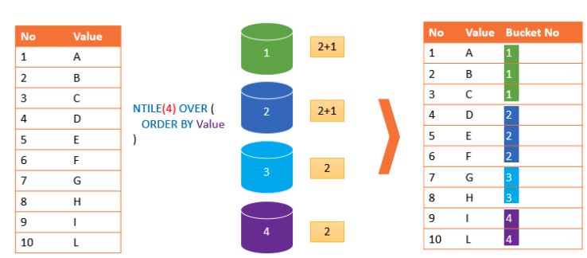
NTILE() – Overview and Logic
NTILE() function is used to divide data into Tiles(Groups) and returns the number of the tile to which the row belongs.
Part of the family ranking functions.
Format: NTILE(n) OVER (PARTITION BY <expression>[{,<expression>...}]
ORDER BY <expression> [ASC|DESC], [{,<expression>...}] )
E - Commerce Purchase Data Analysis – Team 7

Slide 3
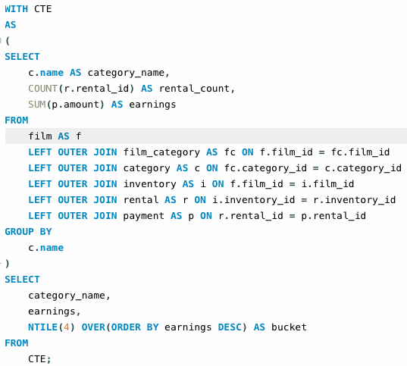
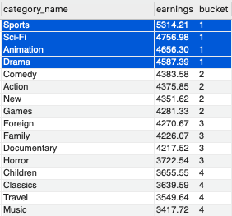
Classify the film genres into buckets based on top earnings ?
E - Commerce Purchase Data Analysis – Team 7

Slide 4
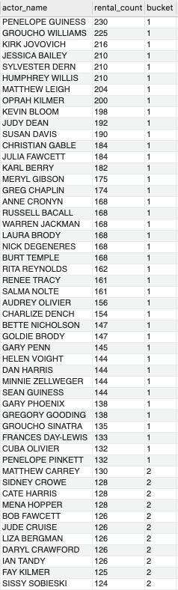
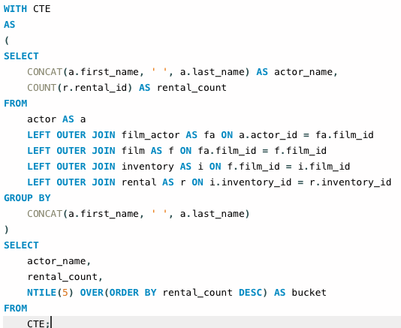
Classify actors into buckets of most rented (demand)?
E - Commerce Purchase Data Analysis – Team 7

Slide 5
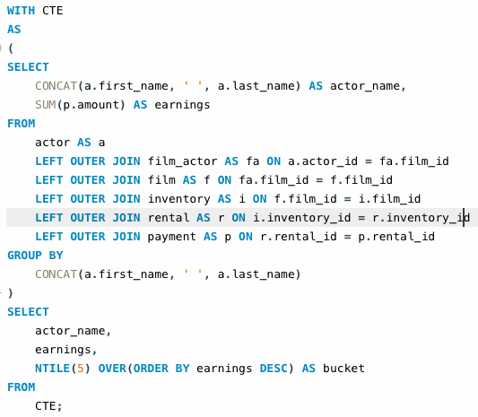
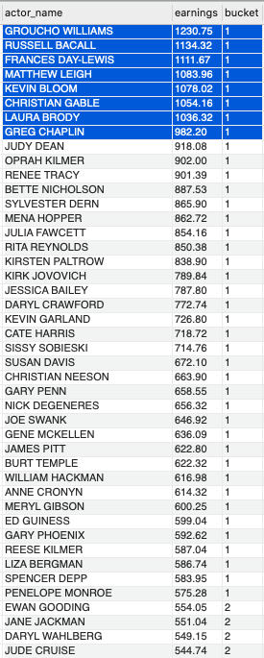
Which actors are most promising to invest based on current earnings?
E - Commerce Purchase Data Analysis – Team 7

Slide 6
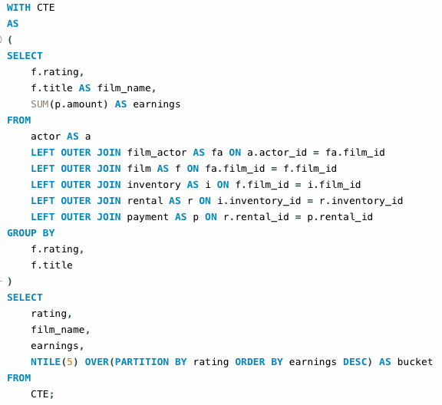
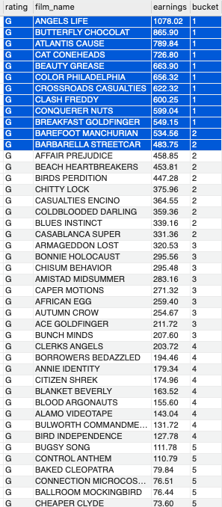
Bucket list of movies based on ratings and best earnings?
E - Commerce Purchase Data Analysis – Team 7

Slide 7
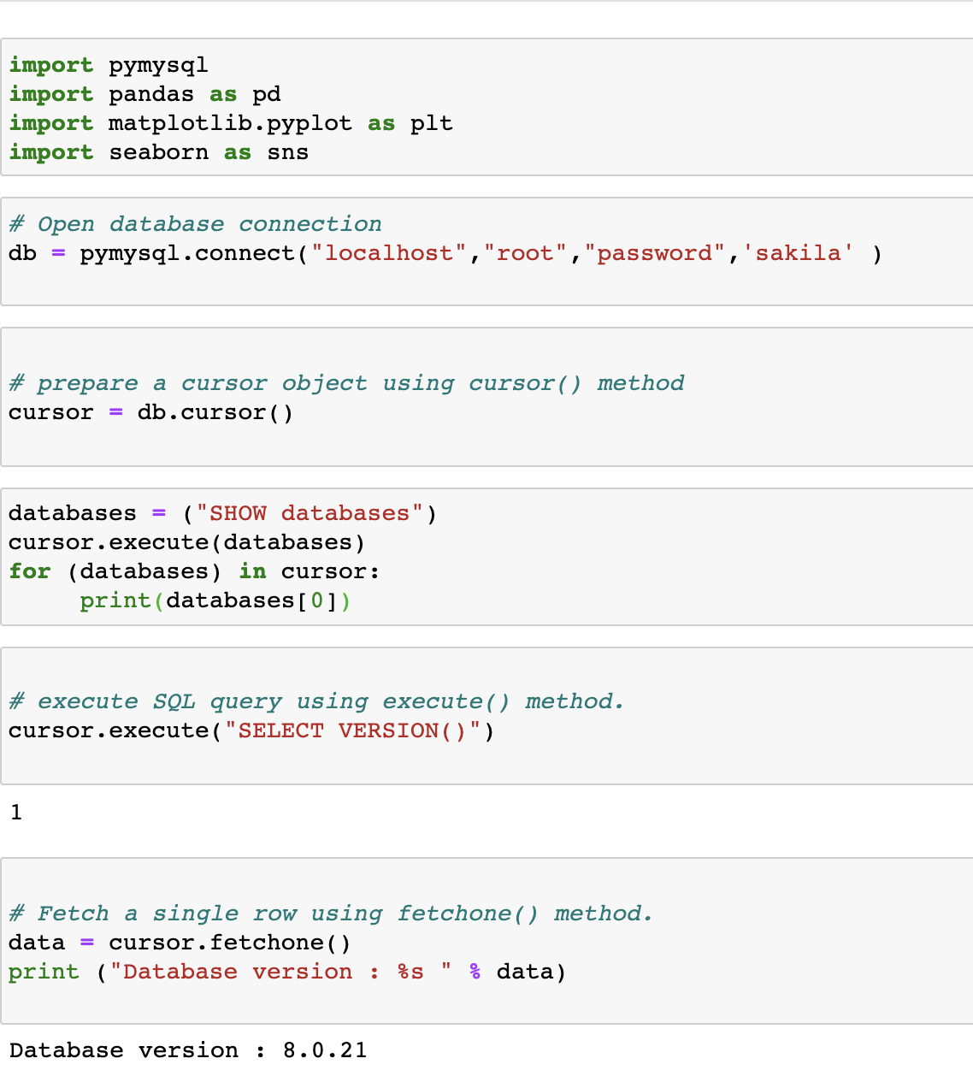
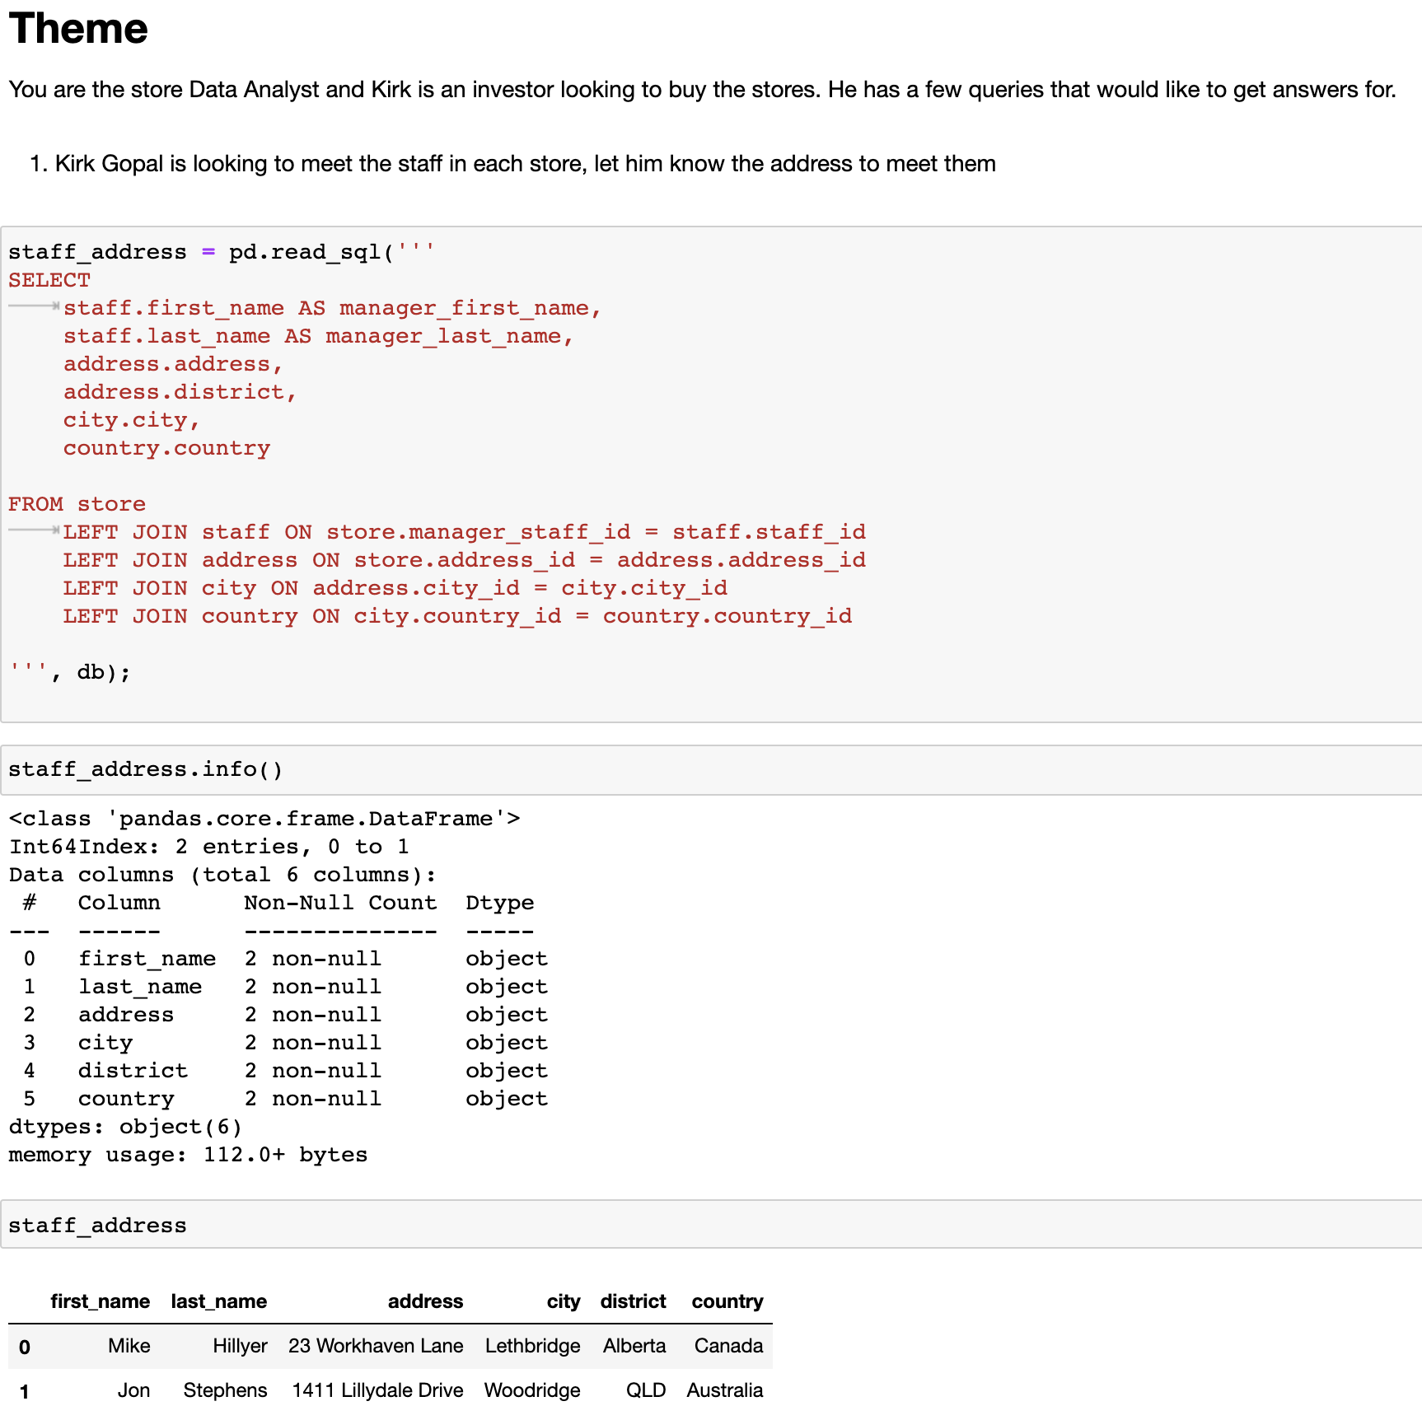
Python and SQL Connectivity, Sample 1

Slide 8
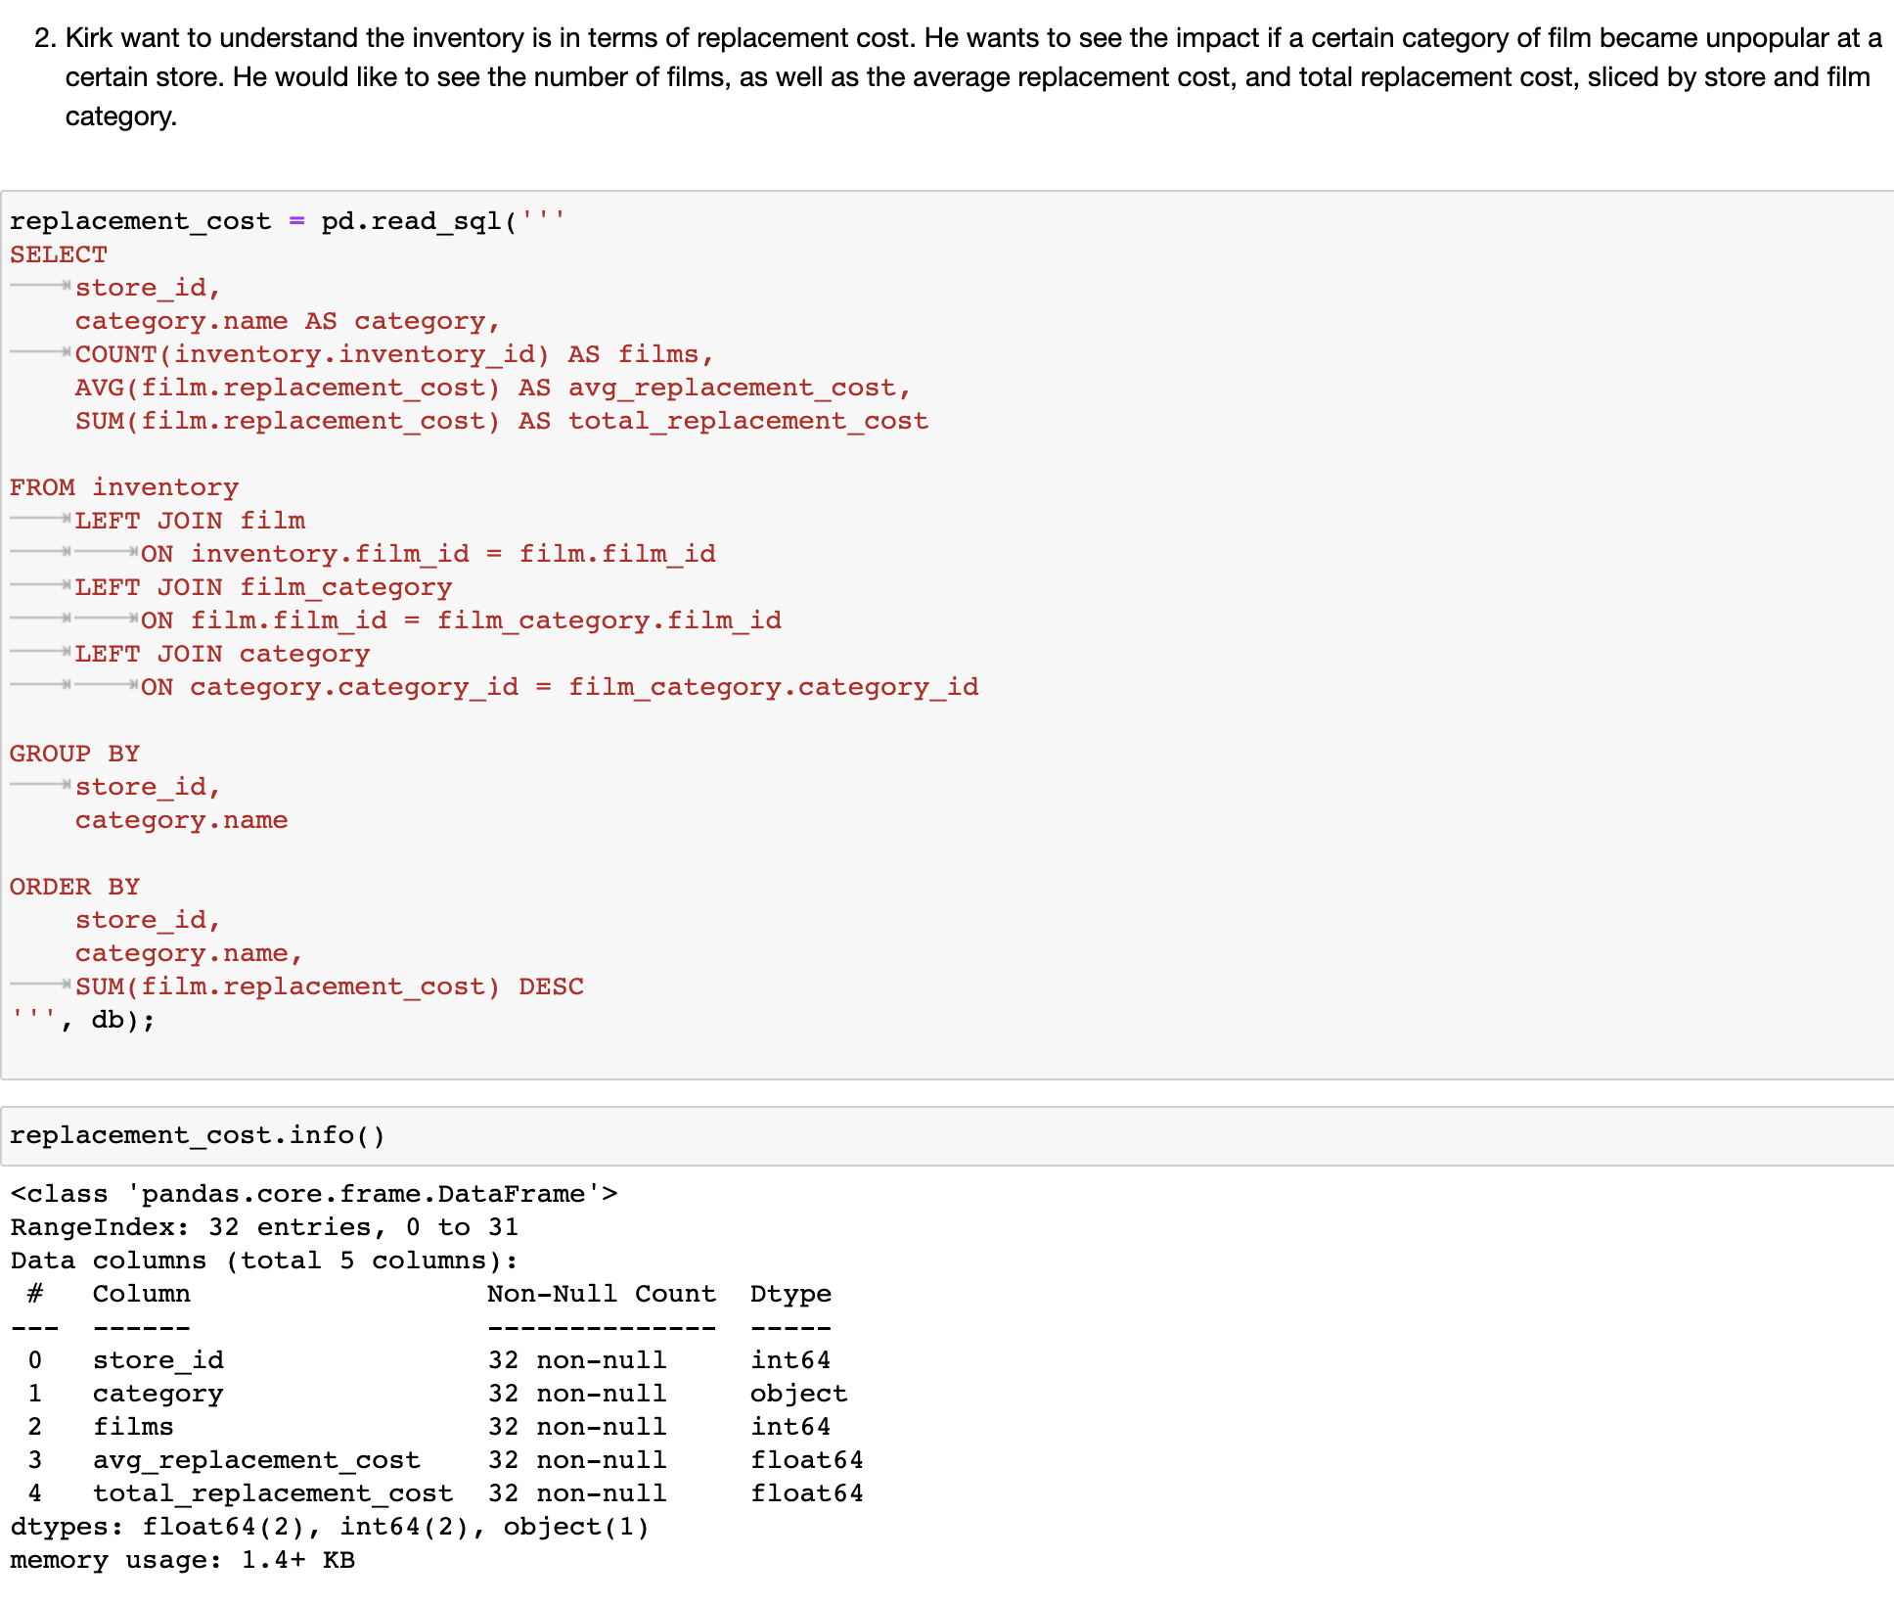
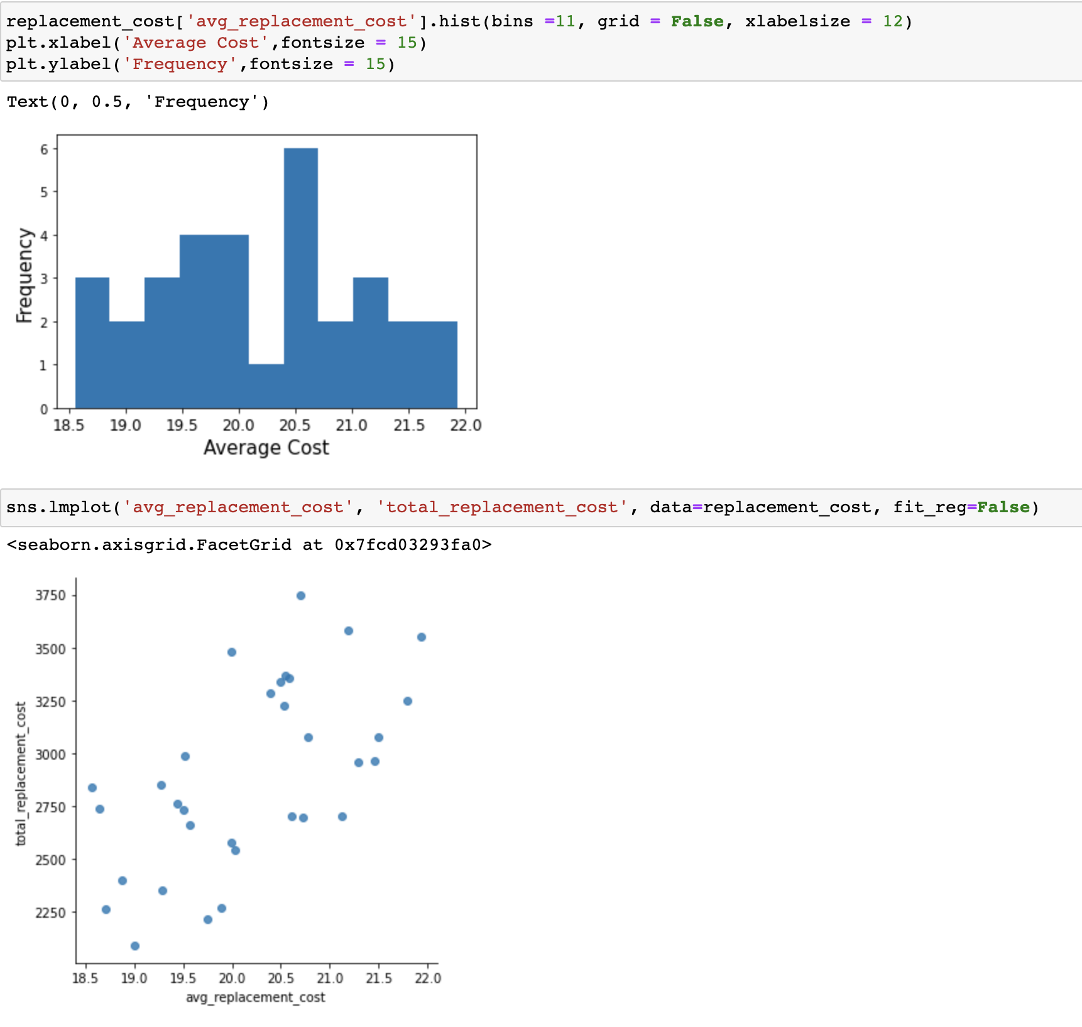
A Multiple Join Query - Sample 2

Slide 9
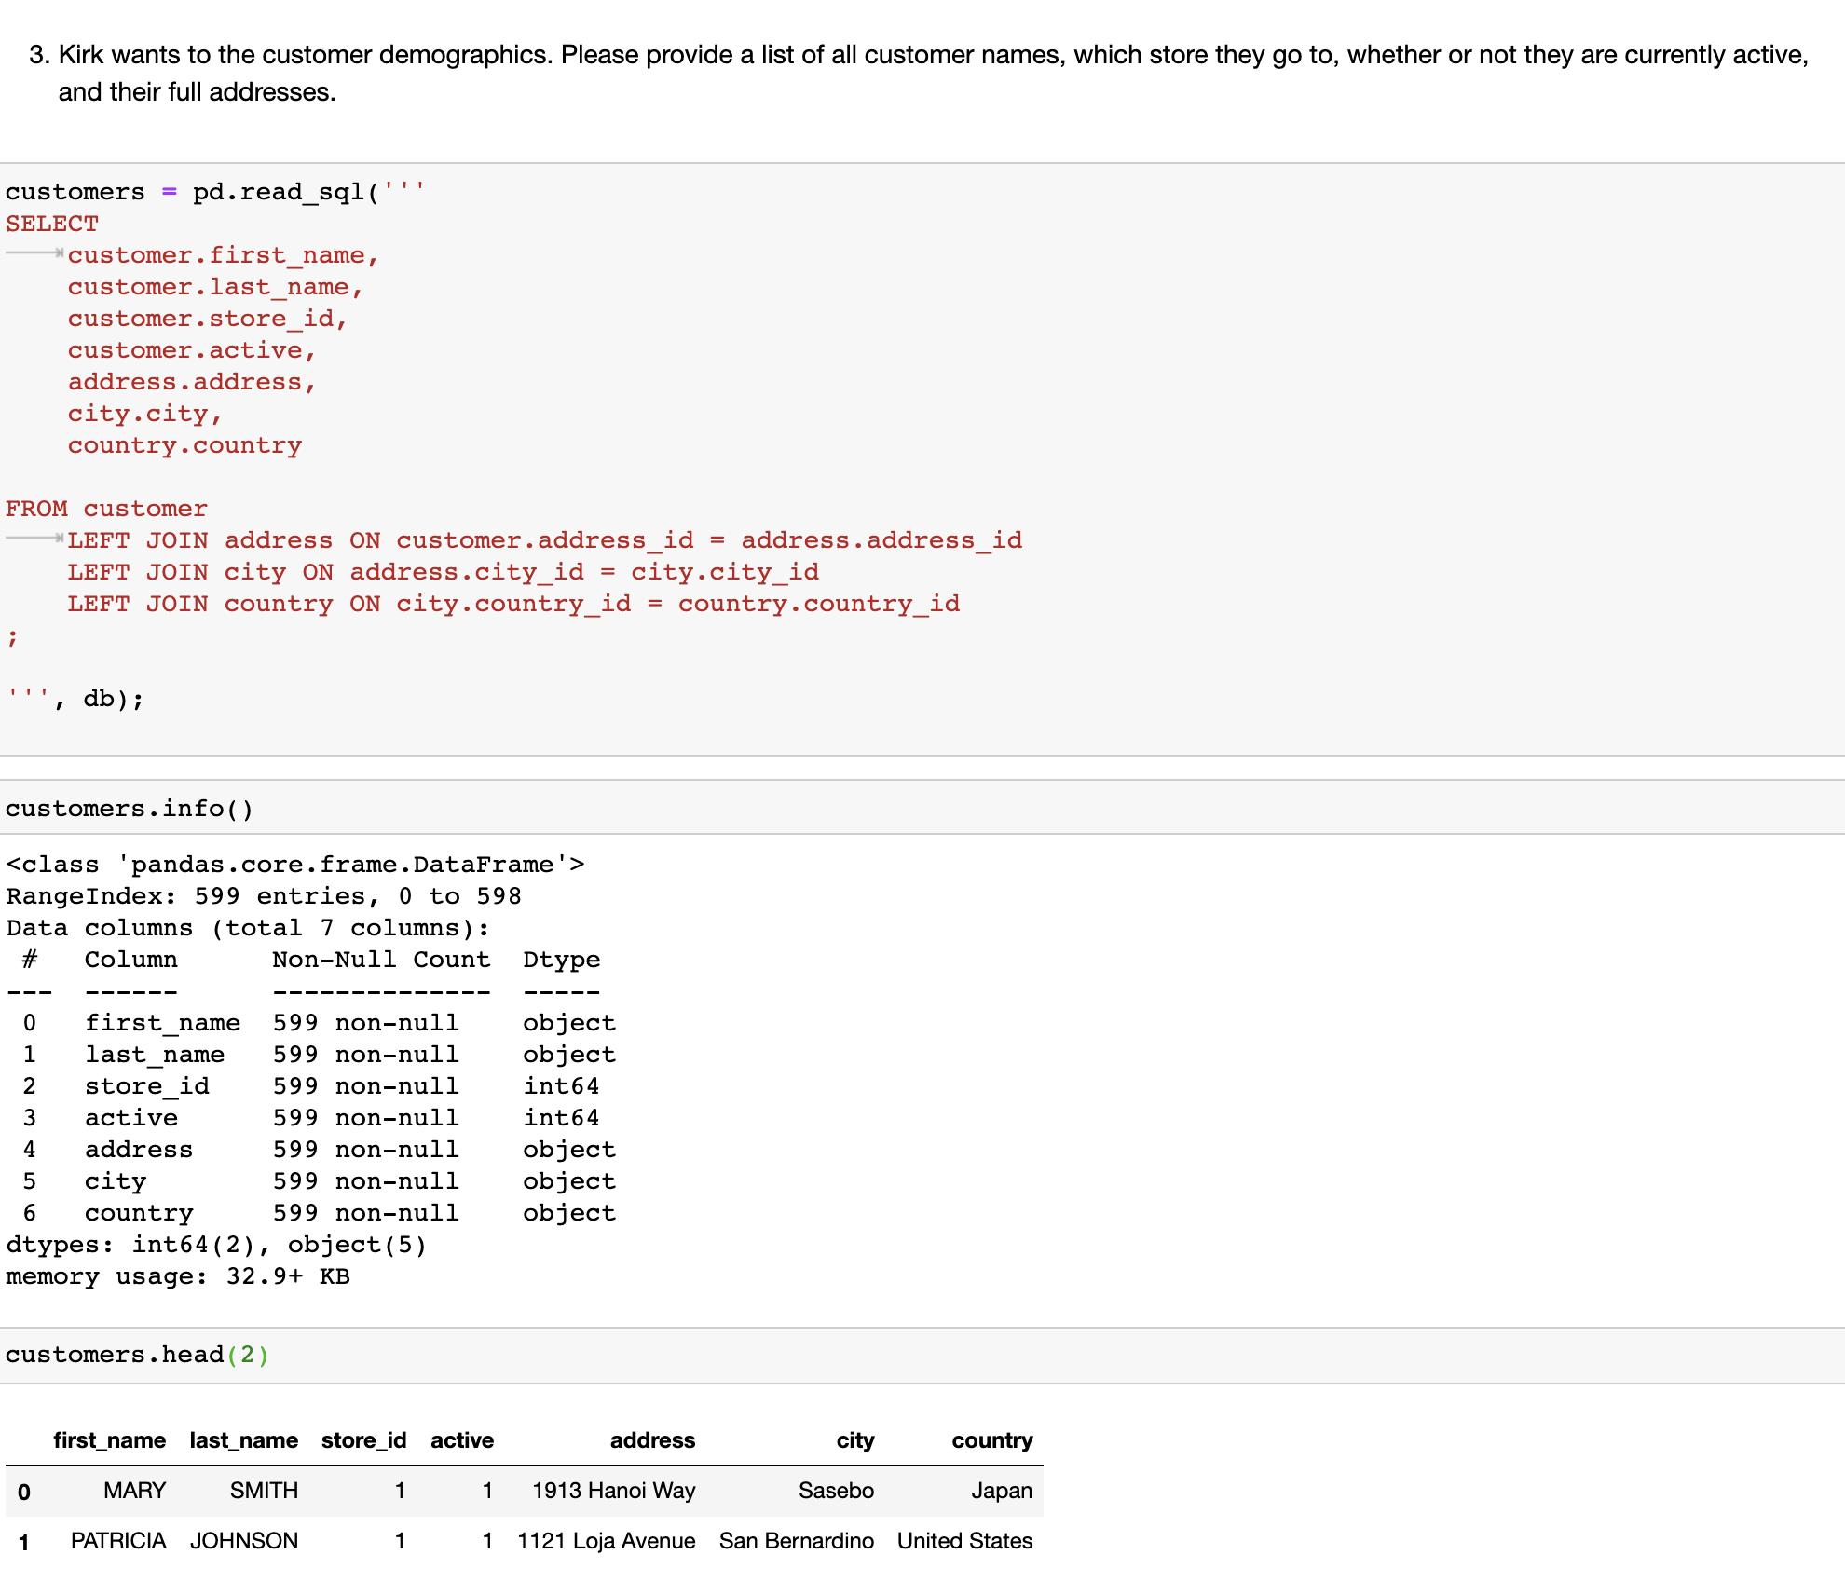
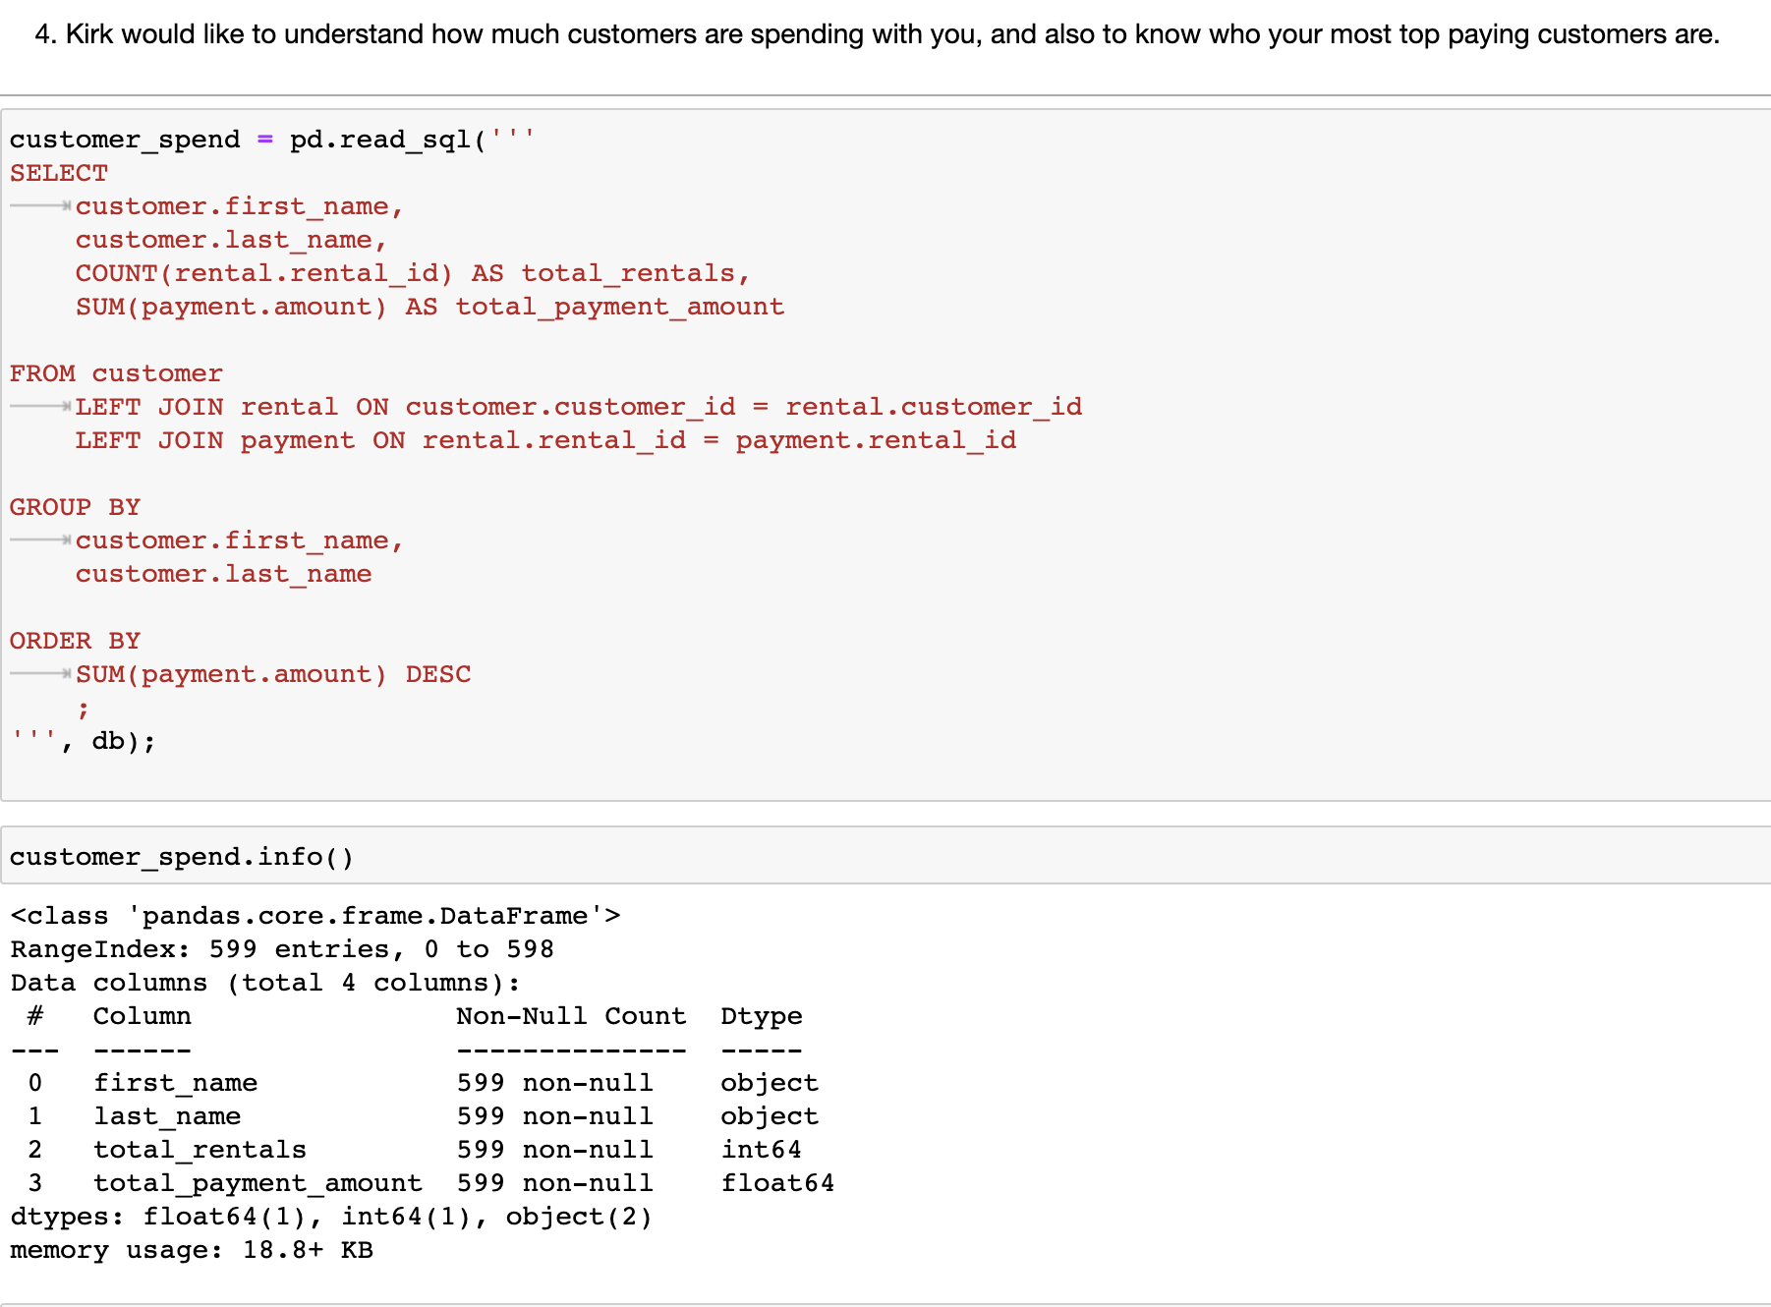
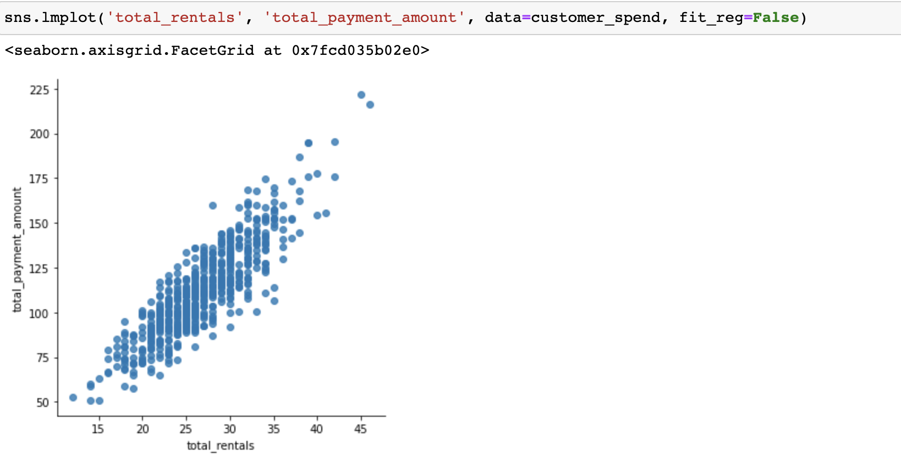
A Multiple Join Query - Sample 3 & 4

Slide 10
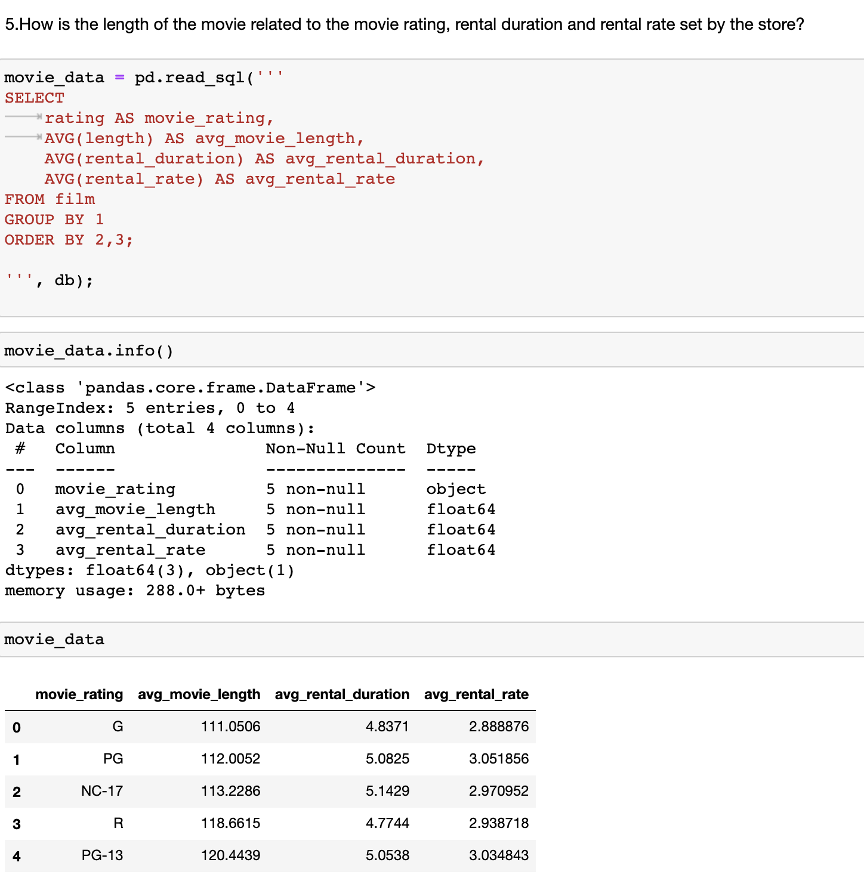
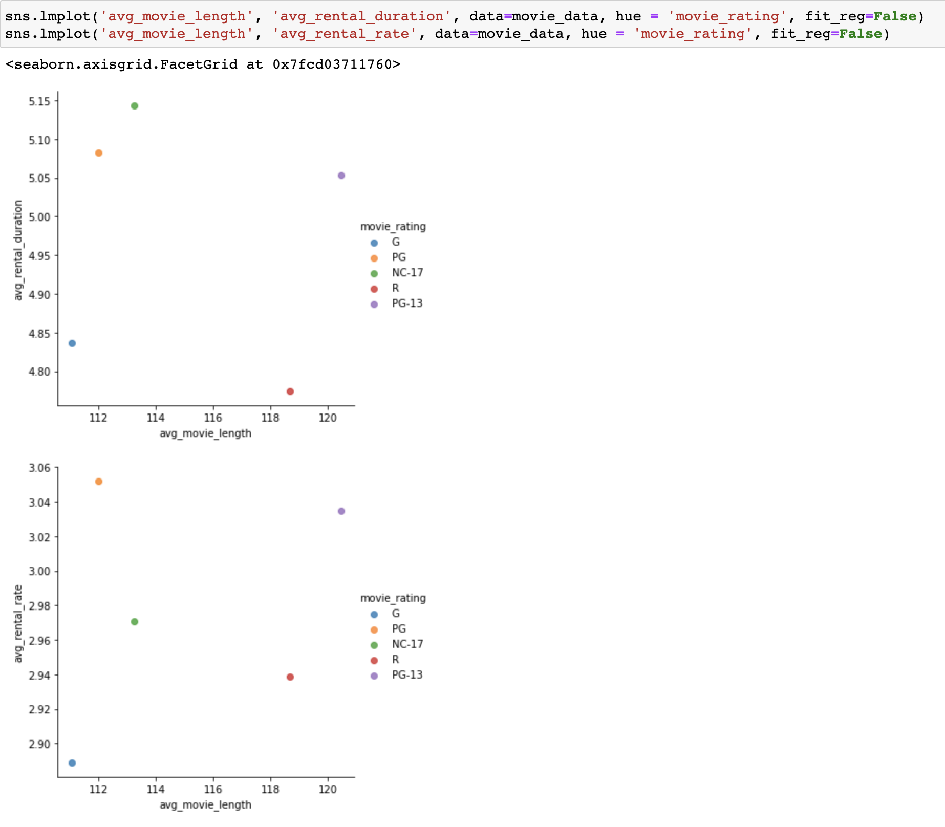
Another Query - Sample 5

Slide 11
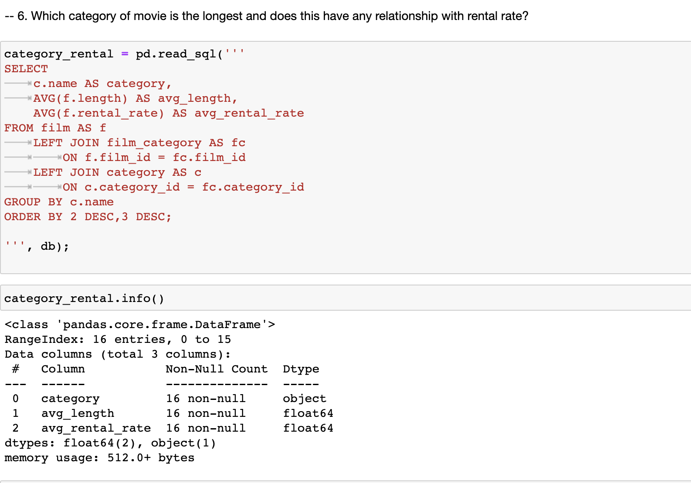
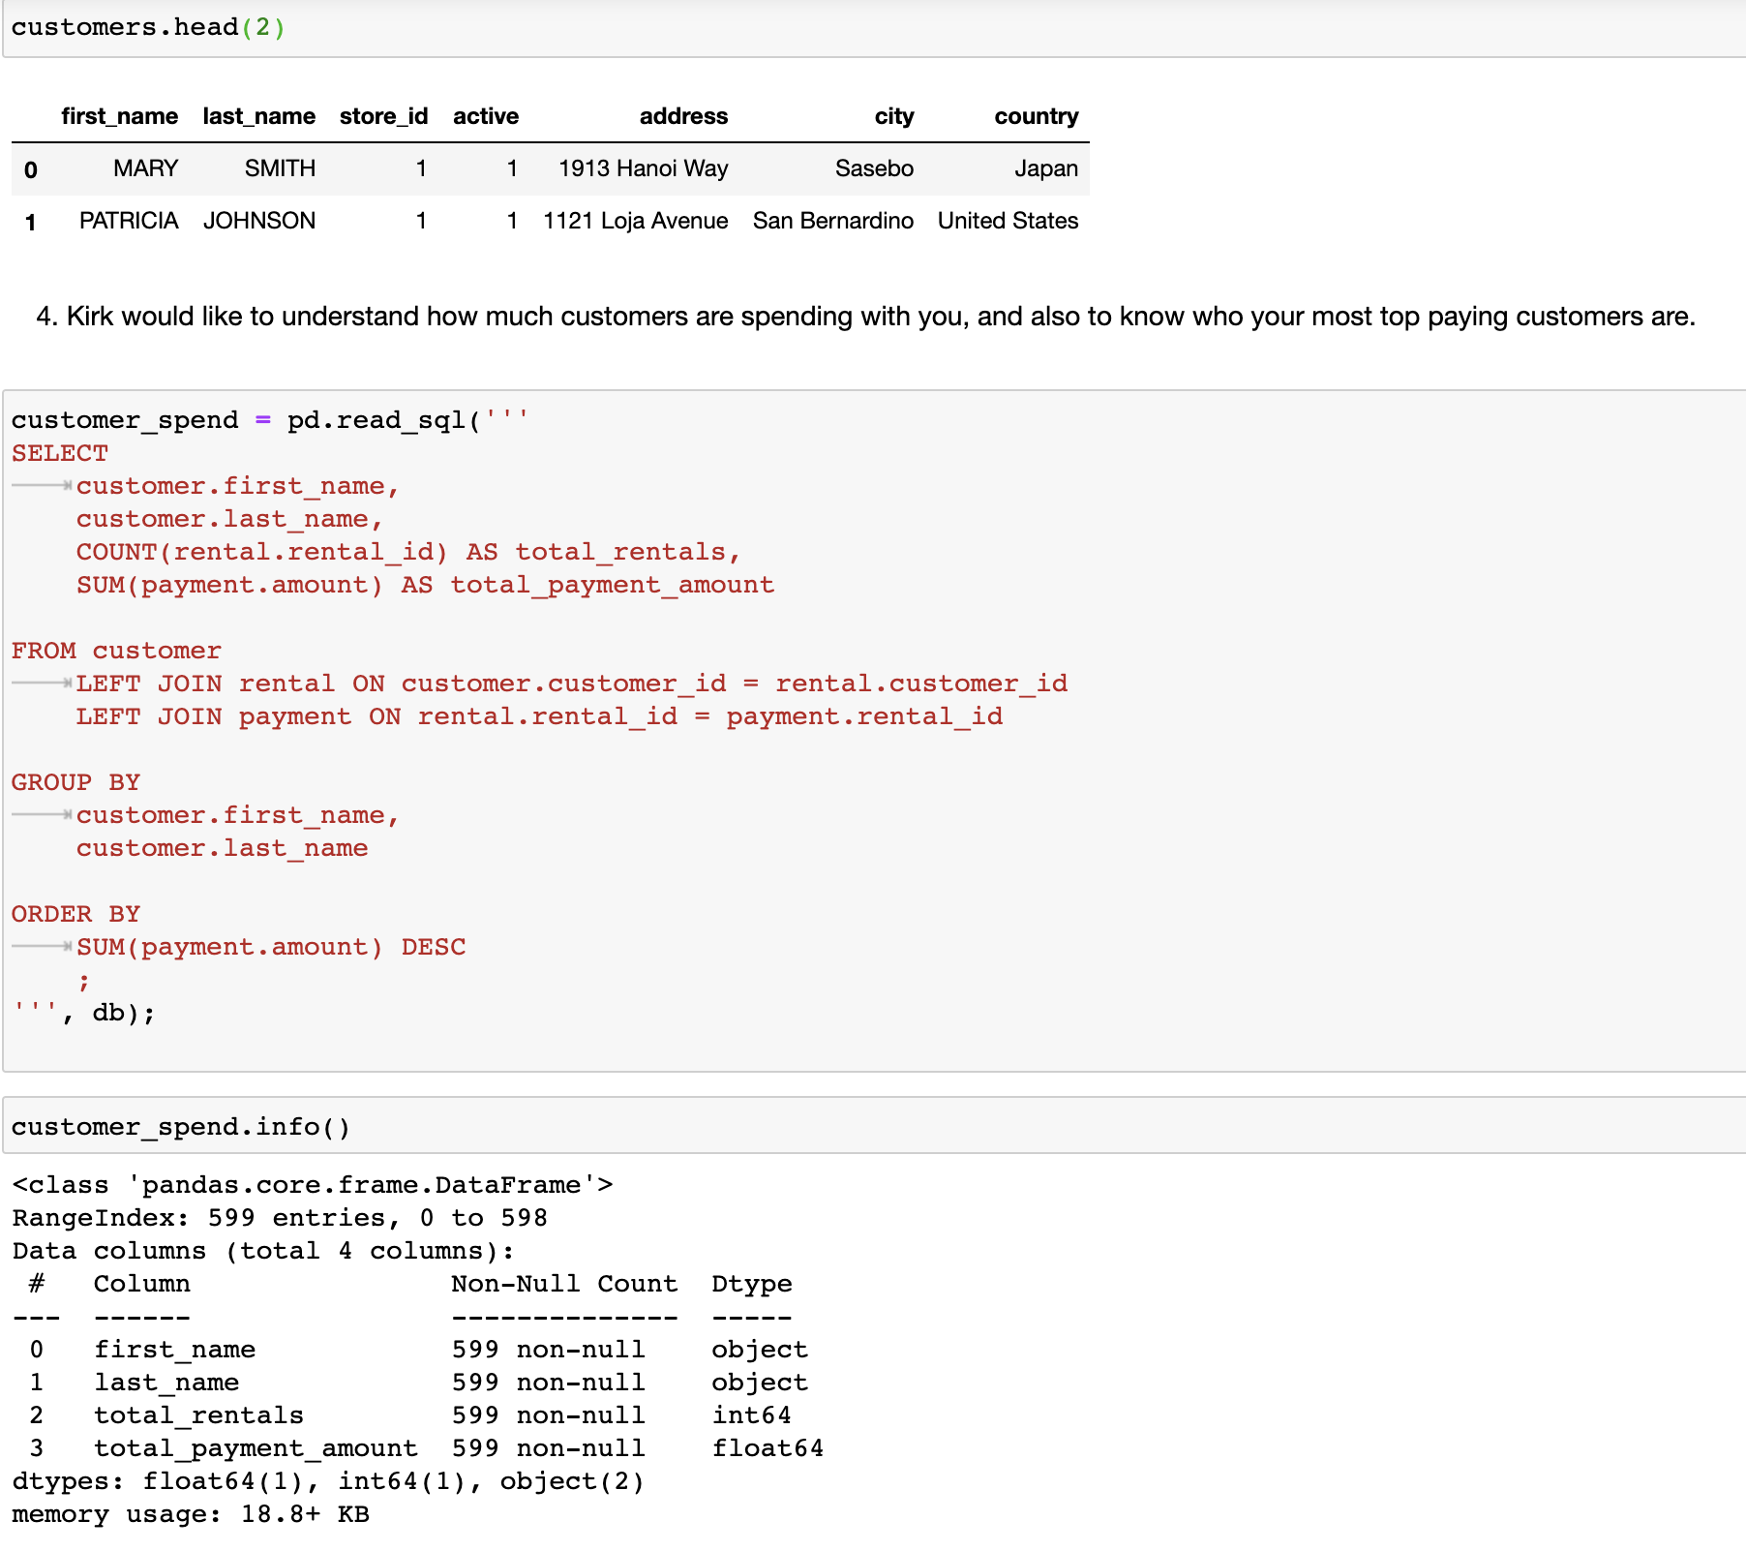
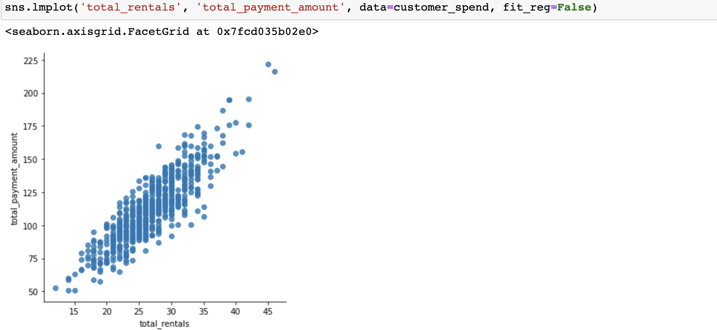
Another Query - Sample 6

Slide 12
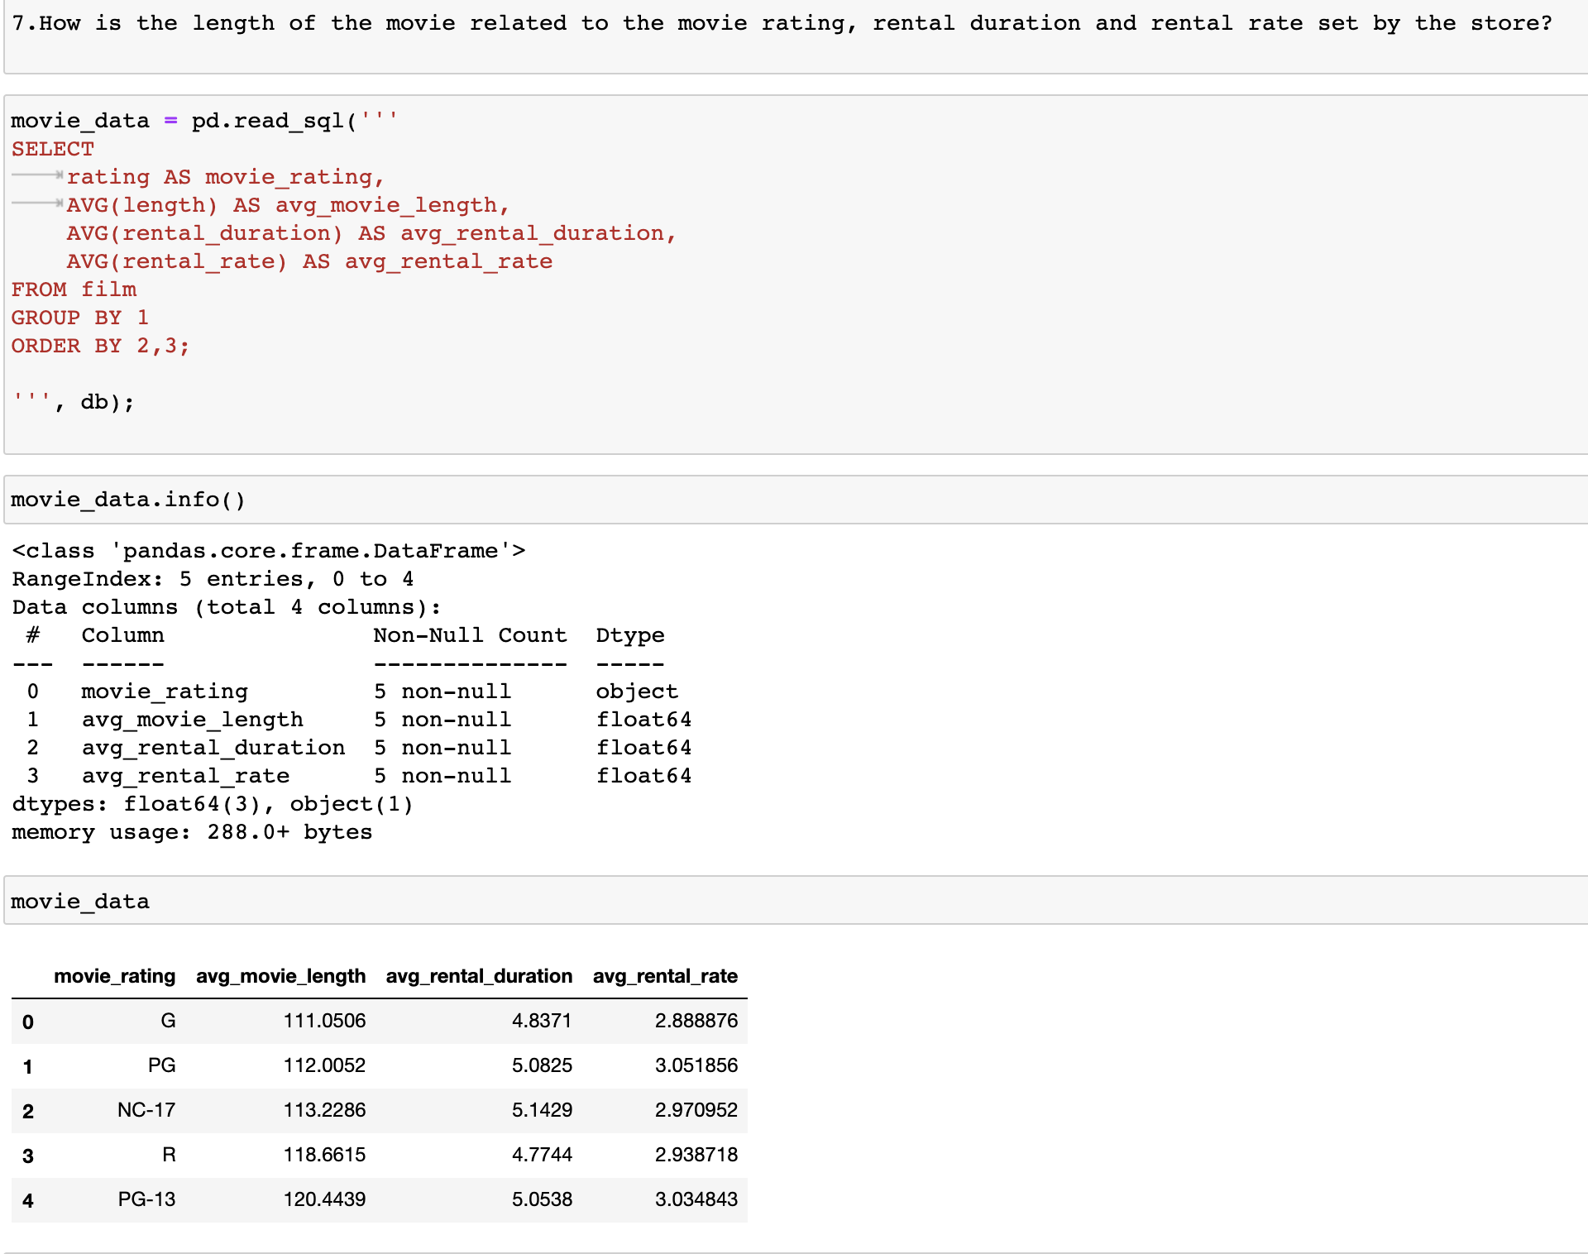
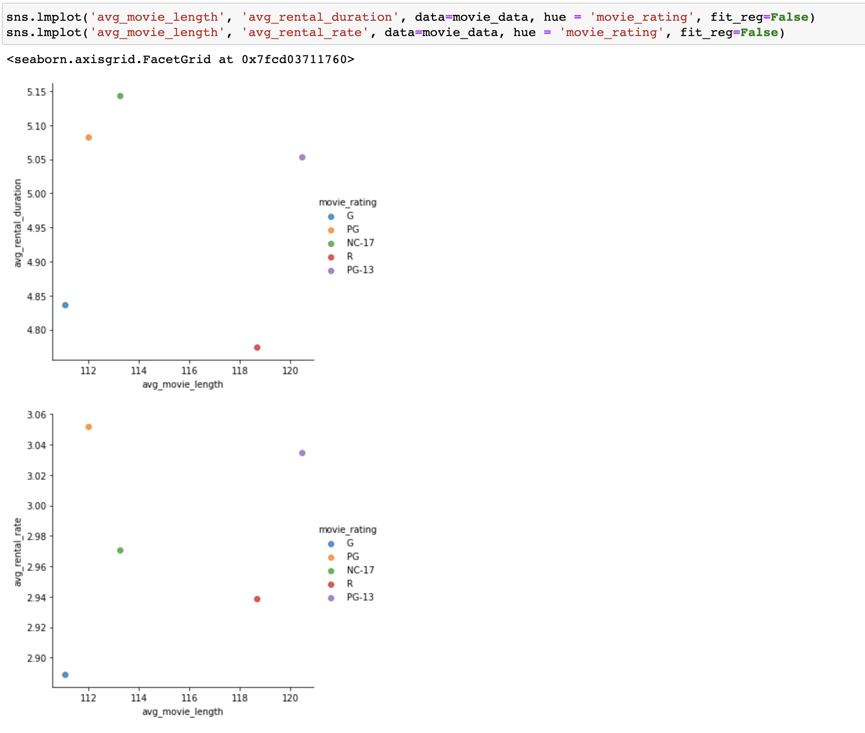
Another Query - Sample 7

Slide 13
Another Query - Sample 8

Slide 14
Thank You!
Project Team
PRAVEEN MANOHAR G
RAHUL A
RAJESH RAMACHANDER
RANJITH GNANA SUTHAKAR ALPHONSE RAJ

